Slide 1
R YOU READY FOR SQL 2016?
R and SQL Server R Services
John Pertell
Database Administrator for Dialysis Clinics Inc
Email: jpertell@gmail.com
Twitter: @jayape
Blog: http://www.pertell.com/sqlservings

Slide 2
Who I am...
Working for DCI since 2000
Started as Access report writer
Have been Senior DBA since 2006

Slide 3
Who I am...NOT!
I am not an “R” tist

Slide 4
Agenda
A little R background
Quick look at basic R
Microsoft and R
Microsoft R Open (MRO)
Microsoft R Server
R and SQL 2016
What is it
Installing and configuring
Using R and SQL 2016

Slide 5
A Little R Background
Open source language used for working with data (statistics, analysis, visualization)
One of the fastest growing, most popular languages for data scientists
Connects to many data sources
Runs on multiple platforms
Available from the CRAN repository
Constantly growing

Slide 6
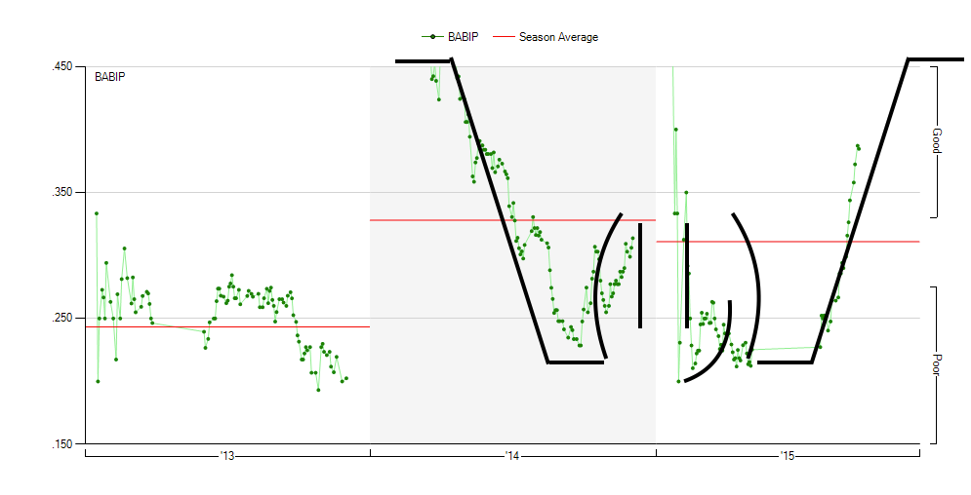

Slide 7
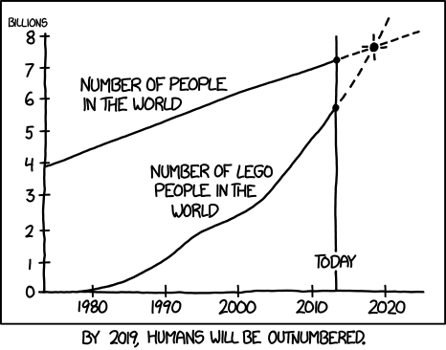
http://xkcd.com/1281/

Slide 8
A Little “R”efresher
Basic atomic classes of objects
Character
Numeric
Integer
Logical (True or False)
Most basic object is a vector
Can only contain objects of the same class (character, etc)
But you can create a list with different classes

Slide 9
A Little “R”efresher
Other object types:
Matrix – vectors with dimensions
Each element must be the same object class
Factors – represent categorical data
Useful for modeling data
Use labels (“Yes”, “No”) instead of integer(1, 2)
Data Frames – stores tabular data
Can store different object classes

Slide 10
A Little “R”efresher - Syntax
# | Comments | # This is a comment
<- or = | Assignment (<- is preferred) | a <- 1 or b = 2
a[1] | First element in a vector | a[1]
df[ , ] | Select data frame element | df[ , 1] = all rows in first column df[1, ] = first row in all columns
c() | Concatenation | a <- c(1, 2, 3, 4, 5)
: | Sequence | a <- c(1:5), same as above
== | Is Equal To | If (a == 1)
!= | Is Not Equal To | If (a != 1)

Slide 11
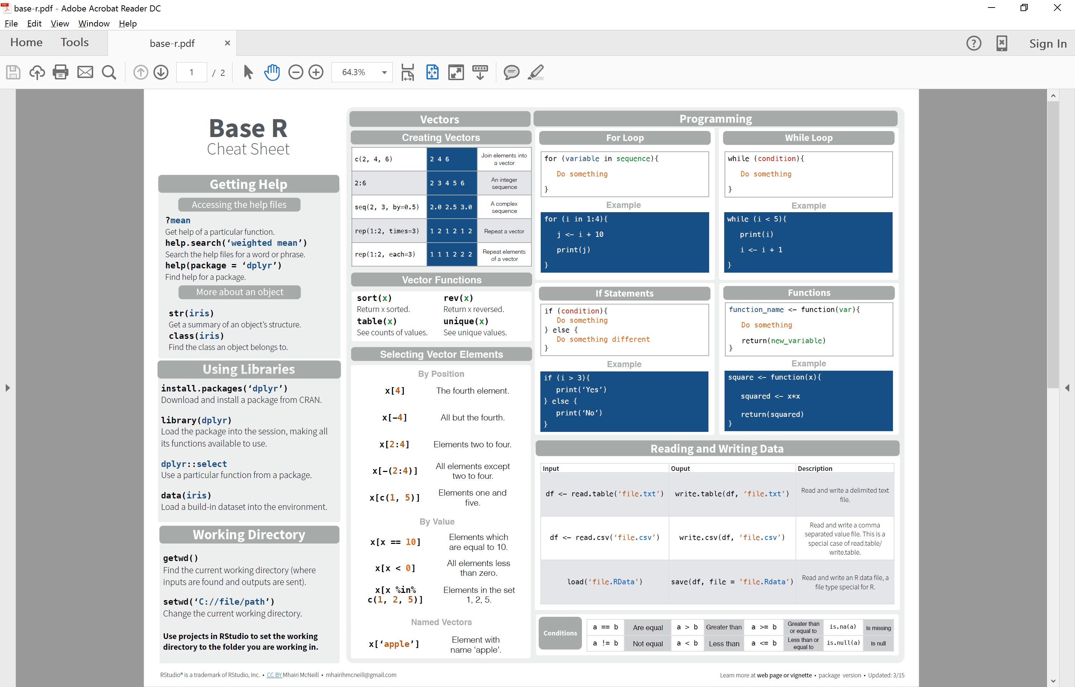

Slide 12
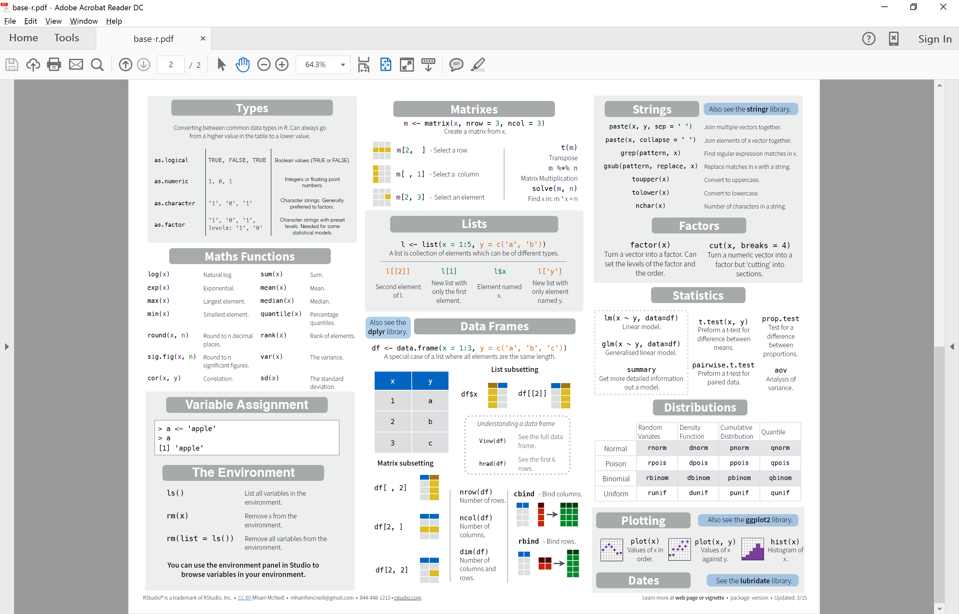

Slide 13
A Little “R”efresher - Packages
install.packages(“package name”, lib = “path”)
lib = optional, path where package is installed
May be asked for mirror path
library(package name, lib.loc = “path”) – load package for use
Lib is optional
Some popular packages
ggplot2 – plots
dplyr – manipulating data
RODBC – connections to ODBC data sources

Slide 14
R Demo

Slide 15
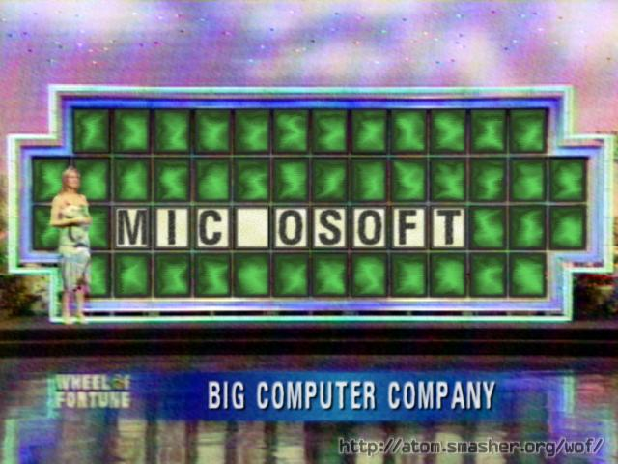
Microsoft and R

Slide 16
Microsoft and R
Microsoft acquires Revolution Analytics in early 2015
Announce integration of R and SQL 2016
Platinum member of R Consortium
MRAN (Microsoft R Application Network)

Slide 17
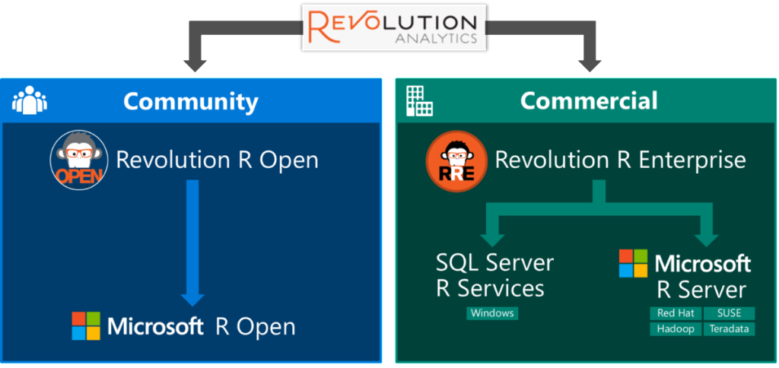
http://blog.revolutionanalytics.com/2016/01/microsoft-r-open.html

Slide 18
Microsoft R Open
Free and open source R distribution
Enhanced version of base R released by Revolution Analytics
Performance
Multithreading (available through MKL)
Package Time Machine (checkpointing) for reproducible code
Same functionality and access to R packages
Use any IDE to run scripts

Slide 19
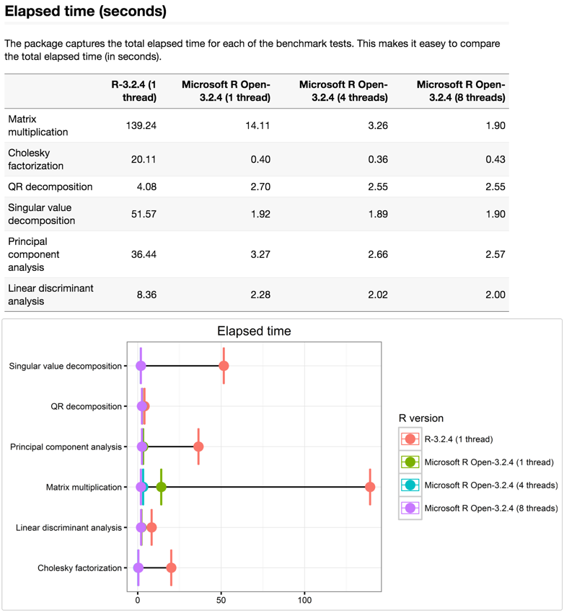
Microsoft R Open – Performance Comparison
SOURCE: https://mran.revolutionanalytics.com/documents/rro/multithread/

Slide 20
Microsoft R Server
Multi-platform (Windows, Linux, Hadoop, Teradata)
Parallel and chunked data processing
Work with larger data sets than base R

Slide 21
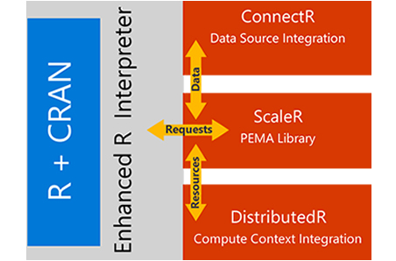
Microsoft R Server

Slide 22
SQL 2016 R Service
R Service (In-Database)
Advanced Analytics Extension
R scripts executed through system stored procedure
Close to the data
Use plots in SSRS

Slide 23
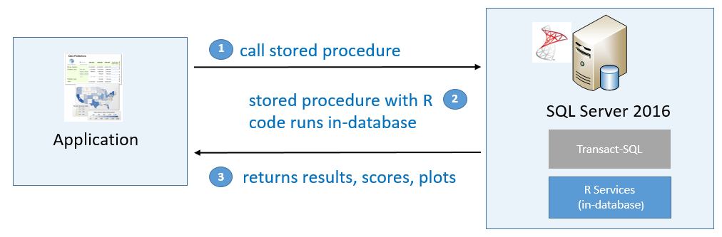
SQL 2016 R Service
SOURCE: https://msdn.microsoft.com/en-us/library/mt604885.aspx

Slide 24
SQL 2016 R Service
Install R Service Standalone if you just want the client
Choose R Services (In-Database) on each instance when installing
Choose R Server if you also want to install the client
If SQL instance is not connected to the internet:
Pause install when you get to screen agreeing to download R Open
Copy download link from popup screen
Download R service components on another computer and move to instance
Resume installation
Run EXEC sp_configure ‘external scripts enabled’, 1 after installation

Slide 25
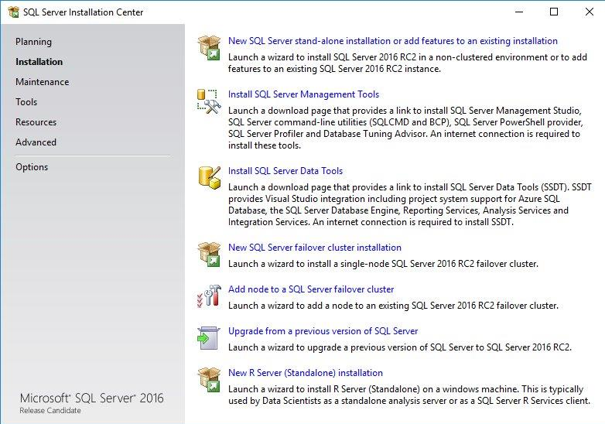

Slide 26
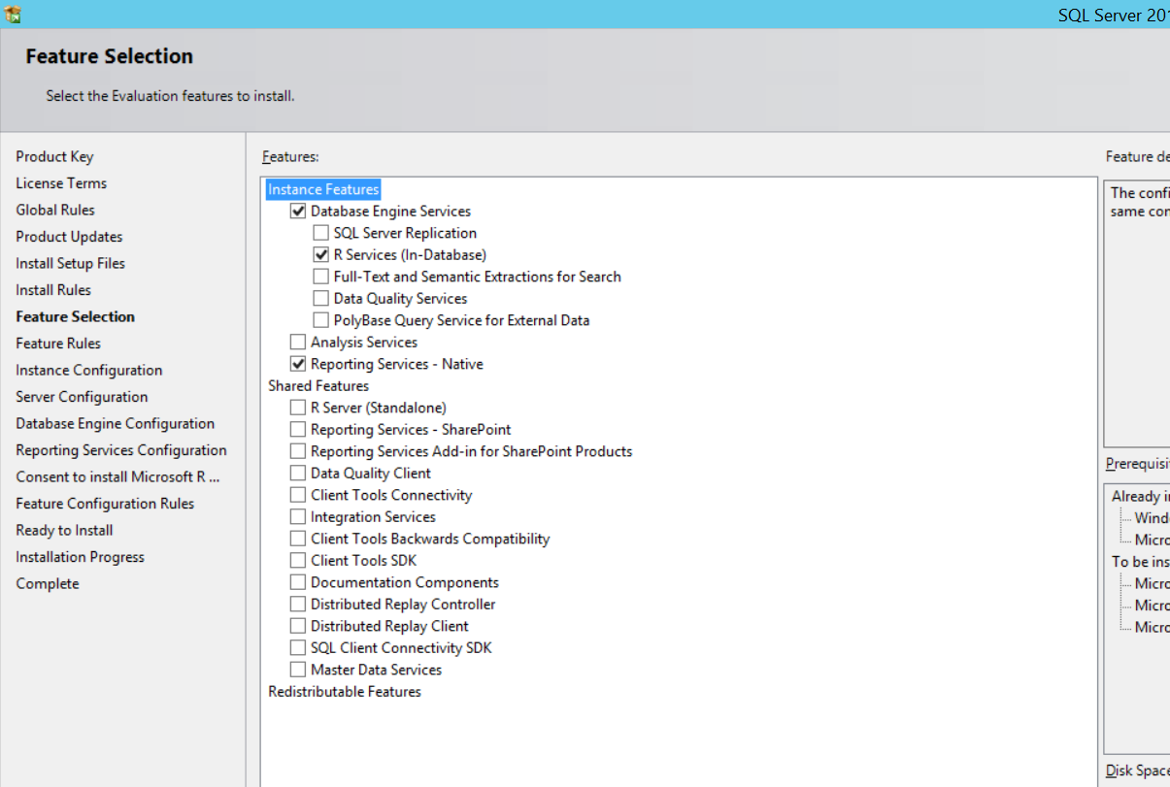

Slide 27
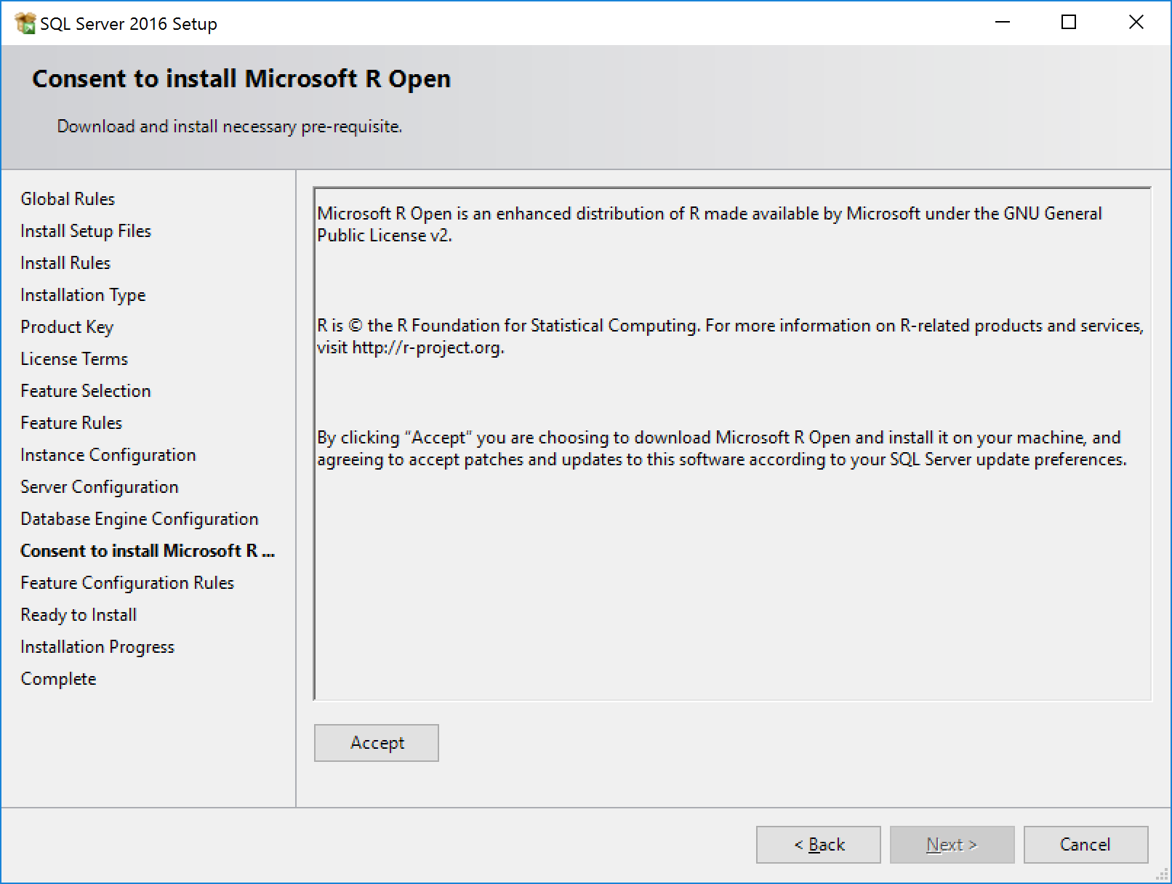

Slide 28
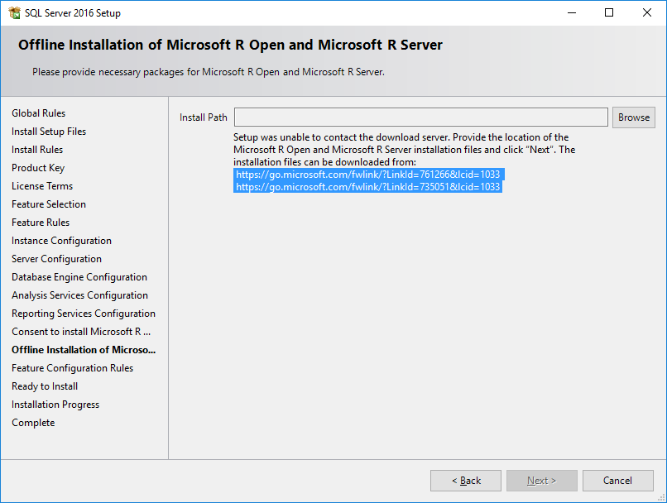

Slide 29
Configure Launchpad Service
<SQL installation path>\binn\Rlauncher.config
MEMORY_LIMIT_PERCENT (default is 20%)
TRACE_LEVEL (default is 1)
USER_POOL_SIZE (default is 0)
Other settings -- MSDN says don’t change
WORKING_DIRECTORY – for R sessions
JOB_CLEANUP_ON_EXIT – default is 1
LOG_DIRECTORY --
RHOME, MPI_HOME – directories for RRO and MPI

Slide 30
Configure RegisterRext.exe.config
C:\Program Files\Microsoft SQL Server\MSSQL13.MSSQLSERVER\R_SERVICES\library\RevoScaleR\rxLibs\x64\RegisterRext.exe.config
<add key="UserAccountPoolSize" value="20" />
Rerun registerRext.exe /uninstall (if you’re already run it once)
Rerun registerRext.exe /install

Slide 31
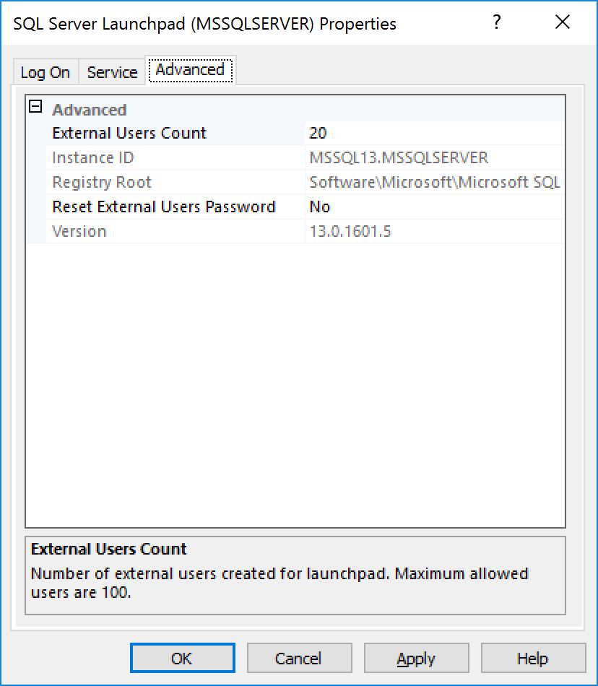
Configure RegisterRext.exe.config
The Easy Button

Slide 32
Packages
Default location C:/Program Files/Microsoft SQL Server/MSSQL13.MSSQLSERVER/R_SERVICES/library
Must install new packages as administrator
Permissions
In database:
GRANT EXECUTE ANY EXTERNAL SCRIPT TO <user name>

Slide 33
EXEC sp_execute_external_script
@language = N’language’,
@script = N’Your R code goes here’,
@input_data_1 = N’’,
[@input_data_1_name = N’’],
[@output_data_1_name = N’’],
[@parallel = 0 | 1],
[@params = N'@parameter_name data_type [ OUT | OUTPUT ] [ ,...n ]' ], [@parameter1 = 'value1' [ OUT | OUTPUT ] [ ,...n ] ]
WITH RESULT_SETS (
{column_name, data_type [,,,n]}
{UNDEFINED}
{NONE})

Slide 34
EXEC sp_execute_external_script…
RESULT SET must be a data frame from R
Only 1 RESULT SET allowed (may be more soon)
Only 1 input_data
Possible workaround – package inside your R code
SQL columns can’t be certain data types (nchar, nvarchar, cursor).
Convert before sending to R
Certain columns can’t recognized by R (AlwaysEncrypted, Masked)
Possible work around – put in temp table first.

Slide 35
SQL 2016 R Demos

Slide 36
SQL 2016 R Known Issues
Parallel execution not in CTP – Fixed in RC
No output parameters in sp_execute_external_script – Fixed in RC
Possible loss of precision between some R and SQL data types.
Only 1 raw value can be returned – multiple outputs planned

Slide 37
Summary - 1
Microsoft acquired Revolution Analytics in 2015
Revolution R Open - Microsoft R Open(MRO)
Free, open source, enhanced version of R
Easier multithreading
Package Time Machine with checkpoint
Revolution R Enterprise - SQL 2016 R Server & Microsoft R Server
Advanced Analytics Extensions
Run R code in database through system stored procedure
Return results and plots to application

Slide 38
Summary - 2
Choose R (In Database)feature during SQL install
Install RRO and RRE (before RC2 or if server has no internet)
Sp_configure ‘external_scripts_enabled’, 1
Configure Rlaunchpad for memory
Configure RegisterRext.exe.config for user account sessions
Run R code through sp_execute_external_script
Only 1 input and 1output
R must return data frame

Slide 39
References
MSDN: SQL Server R Services https://msdn.microsoft.com/en-us/library/mt604845.aspx
MSDN: Getting Started with SQL Server R Services https://msdn.microsoft.com/en-us/library/mt604885.aspx
MSDN: sp_execute_external_script (Transact-SQL) https://msdn.microsoft.com/en-us/library/mt604368.aspx
MSDN: Configure and Manage Advanced Analytics Extensions
https://msdn.microsoft.com/en-US/library/mt590869.aspx
Microsoft R Application Network (MRAN) https://mran.revolutionanalytics.com/

Slide 40
References – 2
MSSQL Tips: Koen Verbeeck – SQL Server 2016 R Services https://www.mssqltips.com/sqlserverauthor/114/koen-verbeeck/
SQL Server R Services Tutorials https://msdn.microsoft.com/en-us/library/mt591993.aspx
AdventureWorks Sample Databases and Scripts for SQL Server 2016 CTP3 https://www.microsoft.com/en-us/download/details.aspx?id=49502
R Tools for Visual Studio beta https://rawgit.com/jflam/VSBlogPost/master/post.html

Slide 41
References – 3
Comprehensive R Archive Network (CRAN) https://www.cran.r-project.org/
R Tutorial https://cran.r-project.org/doc/manuals/R-intro.html
R Cheatsheets https://www.rstudio.com/resources/cheatsheets/

Slide 42
THANK YOU!
John Pertell
Email: jpertell@gmail.com
Twitter: @jayape
Blog: http://www.pertell.com/sqlservings

